Slide 1
Ms. Caproon
AICE AS Global Perspectives
325355@dadeschools.net
Room 5330

Slide 2
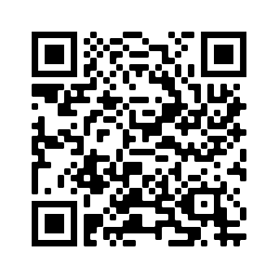
Course Information
Cambridge International Syllabus for AS Global 2023:
https://www.cambridgeinternational.org/Images/595455-2023-2025-syllabus.pdf
Skills Based Course
“. . . involve students in researching current global affairs using a wide variety of media formats such as newspapers, websites, academic journal articles, podcasts and books. . . based on the premise that investigating global issues through a variety of different perspectives will help increase learner awareness of the world around them. . . ”

Slide 3
Cambridge Assessment
3 Components
Component 3 Team Project – Paper 3
(Presentation & Reflective Paper) 32%
Candidates work in teams to identify a local problem which has global relevance. Individual team members research the issue and suggest solutions to the problem based on their research findings. Teams work together to agree a set of proposed team solutions to the problem.
While the focus of the task is on teamwork, each candidate within a team prepares two pieces of work for individual submission. These are:
Presentation – 22%
Each candidate presents an eight-minute live presentation of their individual research and proposed solutions to the problem.
Reflective Paper – 10%
Each candidate explains these team solutions in an individual 800-word reflective paper.
Component 1: Written Exam – Paper 1
(1 hour 30 minutes) 36%
Candidates analyze and evaluate arguments, interrogate evidence, and compare perspectives of sources provided with examination paper.
Component 2: Research Essay – Paper 2
(Between 1750 and 2000 words) 32%
Candidates explore different perspectives on issues of global significance arising from their studies during the course and write an essay based on their research.

Slide 4
Class Rules and Policies
Be
Be Present- E-mail me for assignments if you are absent or have any questions.
Check
Check Schoology Daily
Always
Always Civil – Attacks or slurs of any nature will be not be tolerated.
Always Honest - Plagiarism & Cheating will not be tolerated

Slide 5
Materials Needed
Computer & Internet Access
College Ruled Paper
USB (2 or more GB)
Dark Blue & Black Pens
Binder or Folder with pockets and prongs
Cell phone with video recording

Slide 6
Additional Information
Email Me When You:
Would like to schedule a Phone Call
Want to know how your student is doing in the course
Have any questions
Schoolhouse Covid-19 Protocols:
No food or drink can be consumed in the classroom unless otherwise indicated.
Many assignments will be submitted digitally.
Please make sure you have an individual water bottle.

Slide 7
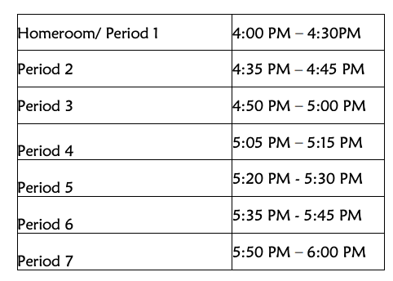
Any Questions?
Where do I go next?

