Slide 1
Welcome To
MAST Academy
2022-23 School Year

Slide 2

Superintendent’s Message

Slide 3

Principal’s Message

Slide 4
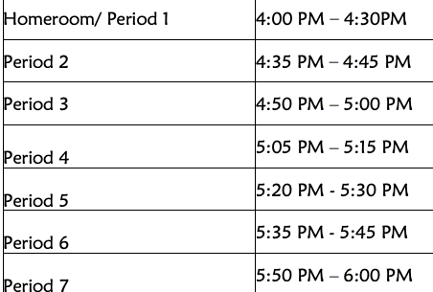
Today’s Schedule
*Homeroom and 1st period are in the same classroom
5 Minutes between periods

Slide 5
What is MAST Academy?
Established in 1990 in Virginia Key
Original building was built for Planet Ocean – a marine museum
School of choice magnet school with three (3) programs
  Maritime
  Cambridge STEM
  Cambridge Global Studies
Vision
Utilizing innovation to educate global citizens.
Mission
Maritime and Science Technology Academy focuses on diversity, environmental awareness, and technology. Our school incorporates a thematic and inquiry-based approach, problem-solving, and experiential learning to provide students with opportunities for life-long learning which impacts the global community.

Slide 6
Probationary Policy
Academic Probation
Disciplinary Probation
Students who do not demonstrate acceptable academic achievement will be placed on probation Parents will be contacted and actions taken to assist the student in meeting MAST's academic requirements. Students who do not show improvement in their unweighted GPA may be recommended for return to their home school. (Please contact your child’s counselor for details)
Due to the high risk of being in, on, or near the water, misbehavior will not be tolerated. Incidents of misconduct may lead a student to be placed on Disciplinary Probation. If necessary, the student will be removed from school and/or reassigned to an alternative school as appropriate.

Slide 7
ATTENDANCE
There are probably no factors more important to a student’s progress in school than regular and punctual school attendance.
Report and explain an absence or tardiness to the school. Failure of the parent/guardian to provide required documentation within three (3) days upon the student’s return to school will result in unexcused absence
Ensure that the child has requested and completes make-up assignments for all excused absences/tardiness from his/her teachers upon his/her return to school or class.
Unexcused absences do not require that the teacher provide make-up work for the student.
Early sign-out of students causes disruption to the academic performance of all students and may create safety and security problems. No students shall be released within the final 30 minutes of the school day unless the principal or principal’s designee determines it is an emergency.

Slide 8
Shipshape Dress
Students are expected to dress appropriately and positively represent MAST Academy, a Nationally Recognized School of Excellence. Keep in mind the Shipshape Dress Code is gender neutral and applies to all students. The following items have been deemed to be inappropriate:
Clothing with obscene/profane/vulgar or sexually suggestive language/pictures or containing references to alcohol, drugs, tobacco, weapons, violence, gangs or bullying
Cut-off clothing or clothing with holes, cut outs, rips or tears.
Clothing that is excessively tight, excessively loose or transparent (includes pajamas, leggings).
Halter tops, tank tops, tube tops, and camisoles.
Blouses/shirts, pants, shorts that expose a bare midriff or underclothes.
Backless shoes, shoes with cleats
Hats, caps, visors, or any head attire that conceals identity.
Sunglasses, headphones, or earbuds.
Shorts, skirts, dresses that are above mid-thigh.
Any clothing or accessory determined by the staff and/or administration to distract other students/teachers from learning/teaching or to constitute a safety or health hazard to others and/or property.

Slide 9
Student Conduct
Students need an environment that is safe and conducive to learning. Students at MAST Academy are expected to follow the MDCPS Code of Student Conduct.
  Students are expected to behave like model citizens
  Students are expected to be responsible and take charge of their education where reasonable
  Students are expected to avoid disruptive behavior, such as;
    Unauthorized location
    Confrontation with another student
    Cutting class
    Disruptive behavior (including behavior on the school bus and at the school bus stop)
    Failure to comply with class and/or school rules including excessive tardies (more than 3)
    Inappropriate items/materials
    Inappropriate public display of affection
    Repeated use of profane or crude language (general, not directed at someone)
    Unauthorized use of electronic devices
    Violation of dress code
    Misrepresentation

Slide 10
