Slide 1
Open House Welcome
to Ms. Garnett’s class
Email:
jgarnett1@dadeschools.net

Slide 2
Attendance
Fill
out
Please fill out the QR Code only once, this attendance is for the office
Sign/
check
Please sign/check before leaving next to your child’s name for my class attendance
Grab
If you would like a parent meeting, please grab a ticket with my email information.

Slide 3
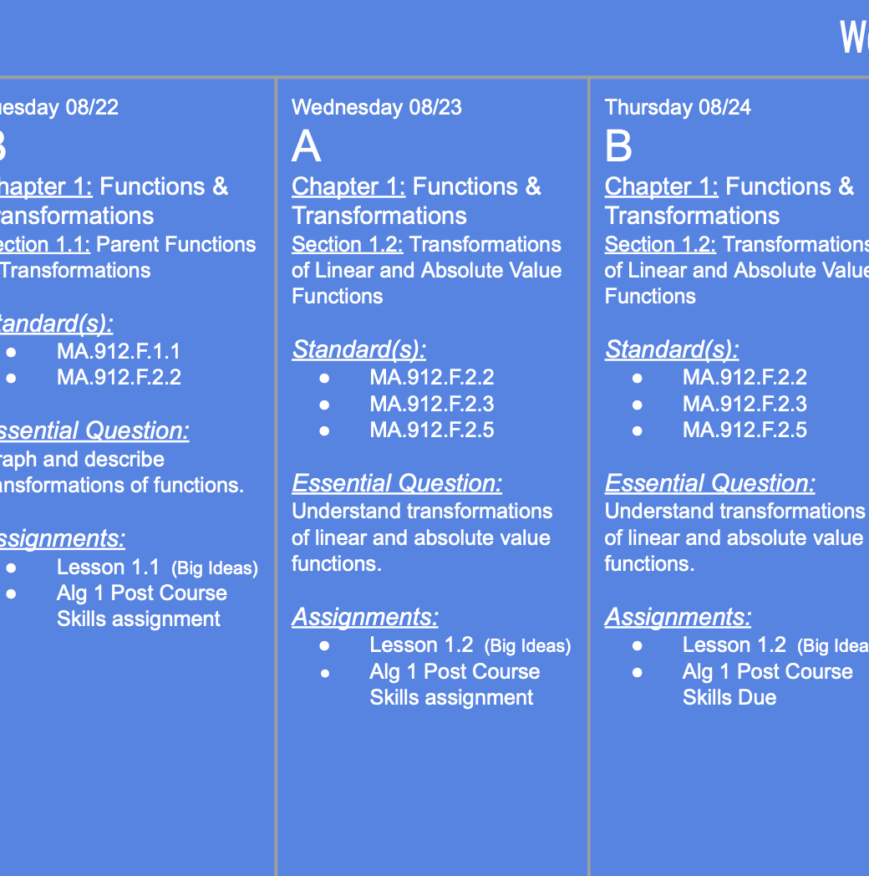
To be successful
Prepare for class - Look Ahead
Students are given a weekly agenda with the chapter and lesson being covered each day.

Slide 4
To be successful Reinforce – Do homework
Use the “See stepped out example” feature when not understanding
Check answers before submitting
Use “Live tutor” and “Solutions” when available
Ask questions during class time.
Seek help if needed, tutoring schedule will be posted in class, on Schoology and on my GoMakos teacher page once available (typically mid October)

Slide 5
To be successful
Master - Study
Do extra Exercise and Practice problems at the end of each section, self-assessment questions, Section Review, and Chapter Reviews (in the physical book or the online book-preferred)
Watch videos/read from the Textbook an additional example from PowerPoint.
Do Skills Trainer on questions not fully understood
Go over lesson PowerPoints completed in class

Slide 6
Grading
Assessments, quizzes and tests, are 50% of the final quarter grade
Classwork, homework, participation, and projects are 50% of final quarter grade
Grades are given as a percent - 0% to 100%

Slide 7
Tutoring
Teacher Tutoring will be announced via the GoMakos site once set up
NHS offers tutoring (more information to come)
Additional tutoring is also posted on my GoMakos teacher page

Slide 8
Wishlist
If you are able and would like to donate to the class the following items it would be greatly appreciated :
Sanitizing wipes/Sanitizing spray/paper towels-to help in keeping the room clean and sanitized through out the year.
Colored paper (various colors)- to use in making foldables and handout copies.

Slide 9
Questions?
Please email me at jgarnett1@dadeschools.net
Thank you and have a wonderful evening!!

